Slide 1
Quiz Game
Unit 1

Slide 2
Branches of Science
Scientific
Inquiry
Science and Technology
Grab Bag
Controlled Experiments
1
1
1
1
1
2
2
2
2
2
3
3
3
3
3
4
4
4
4
4
5
5
5
5
5

Slide 3
Branches of Science for 1
Question:
What are the three main branches of natural science?
Check Your Answer

Slide 4
Branches of Science for 1
Answer:
Physical Science, Earth Science and Life Science are the three main branches of natural science.
Back to the Game Board

Slide 5
Branches of Science for 2
Question: What branch of science would investigate the cells found in a drop of pond water.
Check Your Answer

Slide 6
Branches of Science for 2
Answer: Life science is the branch of science that investigates all life, small or large.
Back to the Game Board

Slide 7
Branches of Science for 3
Question: What branch of science would investigate the conditions during which ice melts.
Check Your Answer

Slide 8
Branches of Science for 3
Answer: Physical science is the branch that studies properties of matter, such as melting.
Back to the Game Board

Slide 9
Branches of Science for 4
Question: What is science and why is it important?
Check Your Answer

Slide 10
Branches of Science for 4
Answer: Science is the study of everything around us and it is important to learn about these things to help us understand the world.
Back to the Game Board

Slide 11
Branches of Science for 5
Question: Which branch of science would study and monitor water erosion of the soil on a roadway.
Check Your Answer

Slide 12
Branches of Science for 5
Answer: Earth science is the branch of science that studies the forces that shape our world, including erosion.
Back to the Game Board

Slide 13
Scientific Inquiry for 1
Question: What is the process of scientific inquiry used for?
Check Your Answer

Slide 14
Scientific Inquiry for 1
Answer: Scientific inquiry is used by everyone to answer a question or solve a problem.
Back to the Game Board

Slide 15
Scientific Inquiry for 2
Question: What is the first step to most scientific inquiries?
Check Your Answer

Slide 16
Scientific Inquiry for 2
Answer:
  Ask a Question
Back to the Game Board

Slide 17
Scientific Inquiry for 3
Question: During a scientific inquiry, after you test your hypothesis, what do you do with the data?
Check Your Answer

Slide 18
Scientific Inquiry for 3
Answer: Analyze it
Back to the Game Board

Slide 19
Scientific Inquiry for 4
Question: A statement that is based on research/observation, testable and tries to predict something is called a _______________.
Check Your Answer

Slide 20
Scientific Inquiry for 4
Answer: A statement that is based on research/observation, testable and tries to predict something is called a hypothesis.
Back to the Game Board

Slide 21
Scientific Inquiry for 5
Question: What is the last step of most scientific inquiries and why is it important?
Check Your Answer

Slide 22
Scientific Inquiry for 5
Answer: Communicate your results. (There are many reasons why it is important. One possible reason is so that other people can learn without having to repeat your experiments.)
Back to the Game Board

Slide 23
Controlled Experiments for 1
Question: What is the independent variable in the following experiment? How can you tell?
group | Plant type | Soil Additive | Time Watered | Number of plants
#1 | Sunflowers | Chemical Fertilizer | 10:00 | 25
#2 | Sunflowers | Manure | 10:00 | 25
#3 | Sunflowers | Compost | 10:00 | 25
#4 | Sunflowers | None | 10:00 | 25
Check Your Answer

Slide 24
Controlled Experiments for 1
Answer: Soil Additive because it is the factor that changes from group to group
group | Plant type | Soil Additive | Time Watered | Number of plants
#1 | Sunflowers | Chemical Fertilizer | 10:00 | 25
#2 | Sunflowers | Manure | 10:00 | 25
#3 | Sunflowers | Compost | 10:00 | 25
#4 | Sunflowers | None | 10:00 | 25
Back to the Game Board

Slide 25
Controlled Experiments for 2
Question: A scientist who wants to study the effects of a new fertilizer on plants would probably
a. include a control group that received no fertilizer.
b. give each experimental group the same amount of the fertilizer.
c. not worry about measuring the amount of fertilizer used.
d. use different numbers of plants in each treatment group.
Check Your Answer

Slide 26
Controlled Experiments for 2
Answer:
A scientist who wants to study the effects of a new fertilizer on plants would probably
a. include a control group that received no fertilizer.
b. give each experimental group the same amount of the fertilizer.
c. not worry about measuring the amount of fertilizer used.
d. use different numbers of plants in each treatment group.
Back to the Game Board

Slide 27
Controlled Experiments for 3
Question: Which group is the control group? How can you tell?
group | Plant type | Soil Additive | Time Watered | Number of plants
#1 | Sunflowers | Chemical Fertilizer | 10:00 | 25
#2 | Sunflowers | Manure | 10:00 | 25
#3 | Sunflowers | Compost | 10:00 | 25
#4 | Sunflowers | None | 10:00 | 25
Check Your Answer

Slide 28
Controlled Experiments for 3
Answer: Group # 4 because it is not being tested on (no soil additive)
group | Plant type | Soil Additive | Time Watered | Number of plants
#1 | Sunflowers | Chemical Fertilizer | 10:00 | 25
#2 | Sunflowers | Manure | 10:00 | 25
#3 | Sunflowers | Compost | 10:00 | 25
#4 | Sunflowers | None | 10:00 | 25
Back to the Game Board

Slide 29
Controlled Experiments for 4
Question: What are the constant factors in this experiment? How can you tell?
group | Plant type | Soil Additive | Time Watered | Number of plants
#1 | Sunflowers | Chemical Fertilizer | 10:00 | 25
#2 | Sunflowers | Manure | 10:00 | 25
#3 | Sunflowers | Compost | 10:00 | 25
#4 | Sunflowers | None | 10:00 | 25
Check Your Answer

Slide 30
Controlled Experiments for 4
Answer: Plant type, Time watered, Number of plants. Because they are the same in each of the groups.
group | Plant type | Soil Additive | Time Watered | Number of plants
#1 | Sunflowers | Chemical Fertilizer | 10:00 | 25
#2 | Sunflowers | Manure | 10:00 | 25
#3 | Sunflowers | Compost | 10:00 | 25
#4 | Sunflowers | None | 10:00 | 25
Back to the Game Board

Slide 31
Controlled Experiments for 5
Question: Which of the following hypotheses could be tested by this experiment?
a. Sunflowers like to be watered at 10:00
b. Sunflowers are easy to grow
c. Sunflowers grow best when they are in soil with compost
d. When you add things to the soil, it is best to have 25 plants
group | Plant type | Soil Additive | Time Watered | Number of plants
#1 | Sunflowers | Chemical Fertilizer | 10:00 | 25
#2 | Sunflowers | Manure | 10:00 | 25
#3 | Sunflowers | Compost | 10:00 | 25
#4 | Sunflowers | None | 10:00 | 25
Check Your Answer

Slide 32
Controlled Experiments for 5
Answer: Which of the following hypotheses could be tested by this experiment?
a. Sunflowers like to be watered at 10:00
b. Sunflowers are easy to grow
c. Sunflowers grow best when they are in soil with compost
d. When you add things to the soil, it is best to have 25 plants
group | Plant type | Soil Additive | Time Watered | Number of plants
#1 | Sunflowers | Chemical Fertilizer | 10:00 | 25
#2 | Sunflowers | Manure | 10:00 | 25
#3 | Sunflowers | Compost | 10:00 | 25
#4 | Sunflowers | None | 10:00 | 25
Back to the Game Board

Slide 33
Technology for 1
Question: Are technology and science related? Give an example why or why not.
Check Your Answer

Slide 34
Technology for 1
Answer: YES!!! (many possible examples such as technology of the microscope helps us to study microscopic items, which in turn helps us to create smaller technology.)
Back to the Game Board

Slide 35
Technology for 2
Question: What is the definition of technology?
Check Your Answer

Slide 36
Technology for 2
Answer: Technology is anything that has been developed to help make life easier, more enjoyable, or efficient
Back to the Game Board

Slide 37
Technology for 3
Question:
Give an example of when technology helps to advance science.
Check Your Answer

Slide 38
Techonology for 3
Answer:
Many possible answers (such as using technology to understand biology and medical procedures)
Back to the Game Board

Slide 39
Technology for 4
Question:
Give an example of science helping to advance technology
Check Your Answer

Slide 40
Technology for 4
Answer:
Many possible answers (such as understanding wind patterns in order to create more efficient wind turbines)
Back to the Game Board

Slide 41
Technology for 5
Question:
Is language considered technology? Why or why not?
Check Your Answer

Slide 42
Technology for 5
Answer:
Yes, because it was developed to help humans understand and live a better, more enjoyable and efficient life.
Back to the Game Board

Slide 43
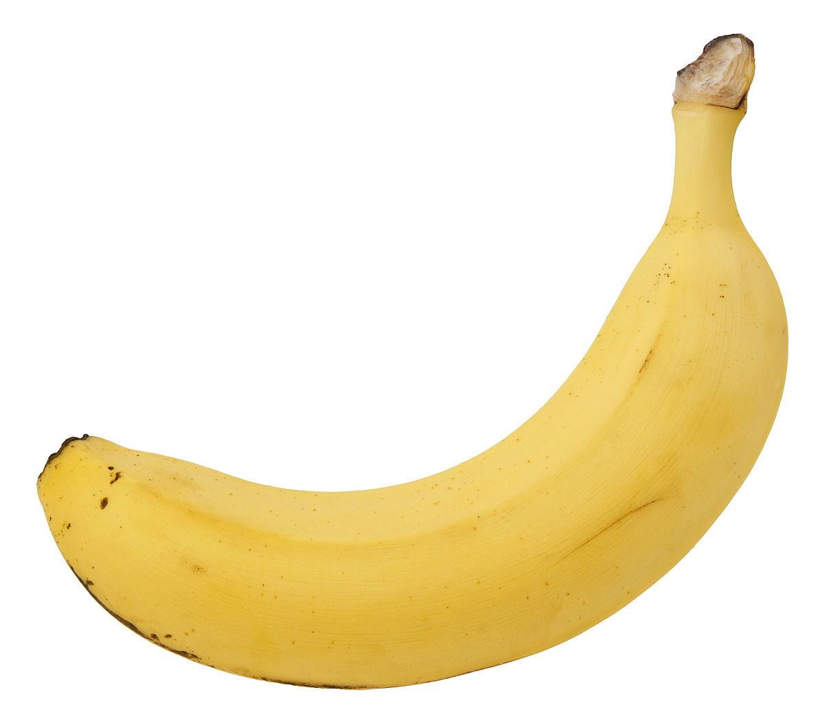
Grab Bag for 1
Question: Is this an observation or an inference?
“The banana is yellow”
Check Your Answer

Slide 44
Grab Bag for 1
Answer:
The fact that the banana is yellow is an observation.
Back to the Game Board

Slide 45
Grab Bag for 2
Question: Does scientific theory or scientific law state what happens/happened?
Check Your Answer

Slide 46
Grab Bag for 2
Answer: Scientific Law
Back to the Game Board

Slide 47
Grab Bag for 3
Question: What causes scientific knowledge to change?
Check Your Answer

Slide 48
Grab Bag for 3
Answer: We are always discovering new things and adding onto existing knowledge
Back to the Game Board

Slide 49
Grab Bag for 4
Question:
A scientific ____________________ is tied together with many experiments, observations, and testing of hypotheses. It is used to try to explain why something happens/happened.
Check Your Answer

Slide 50
Grab Bag for 4
Answer:
A scientific Theory is tied together with many experiments, observations, and testing of hypotheses. It is used to try to explain why something happens/happened.
Back to the Game Board

Slide 51
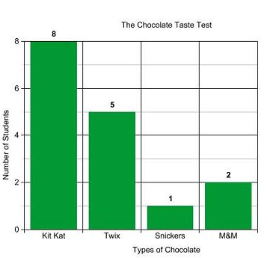
Grab Bag for 5
Question: Mrs. McGowans class had a hypothesis that Twix was the most favorite candy bar. After a test, these were the results. Was their hypothesis correct or not? Why?
Check Your Answer

Slide 52
Grab Bag for 5
Question:
Their hypothesis was incorrect because while 5 students liked Twix, 8 of them liked the Kit Kat better, which was the majority of the students.
Back to the Game Board

